Slide 2
20 Better Ways to Perform Server Administration Using PowerShell
Orin Thomas
M339

Slide 3
Many Server Administrators haven’t had the time to learn PowerShell

Slide 4
This session is about taking day to day tasks that Server Administrators have to perform

Slide 5
And showing how to perform them with a line or so of PowerShell

Slide 6
In this session we will look at the following:

Slide 7
-Basic configuration -Core role tools AD DS File Servers DHCP DNS -Snippits

Slide 8
Basic Configuration Tasks

Slide 9
Rename a computer
Rename-Computer Ignite-NZDemo

Slide 10
Restart a computer
Restart-Computer

Slide 11
Shut down a computer
Stop-Computer

Slide 12
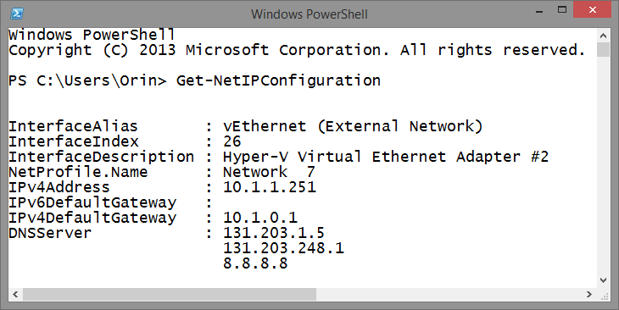
Determine IP Address
Get-NetIPConfiguration

Slide 13
Set IP Address
New-NetIPAddress -InterfaceAlias Ethernet -IPAddress 172.16.0.20 -PrefixLength 24 -DefaultGateway 172.16.0.1

Slide 14
Configure DNS Server
Set-DNSClientServerAddress -InterfaceAlias "Ethernet" -ServerAddresses 172.16.0.10

Slide 15
Join a domain
Add-Computer -DomainName igniteNZ.internal

Slide 16
Basic Diagnostics

Slide 17
DEMO: BASIC COMPUTER CONFIGURATION

Slide 18
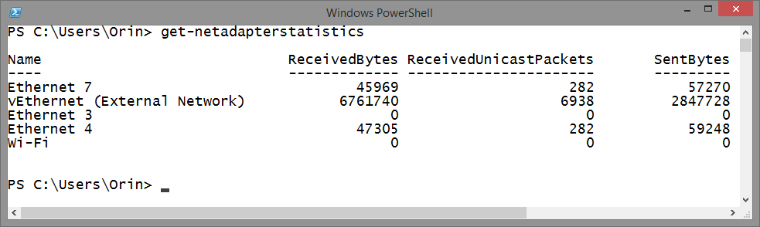
Verify Network Adapter Functionality
Get-NetAdapterStatistics

Slide 19
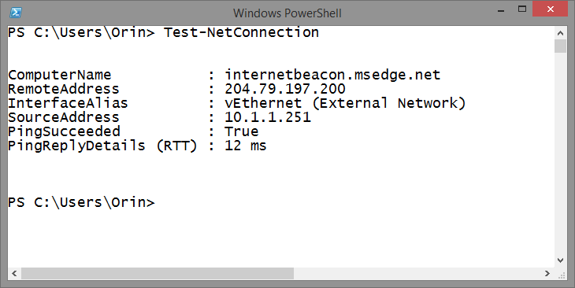
Verify Network Adapter Connectivity
Test-NetConnection

Slide 20
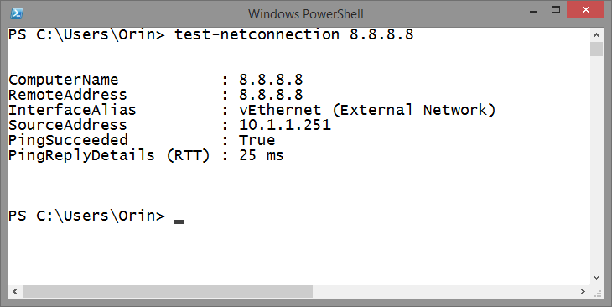
Verify Network Adapter Connectivity
Test-NetConnection 8.8.8.8

Slide 21
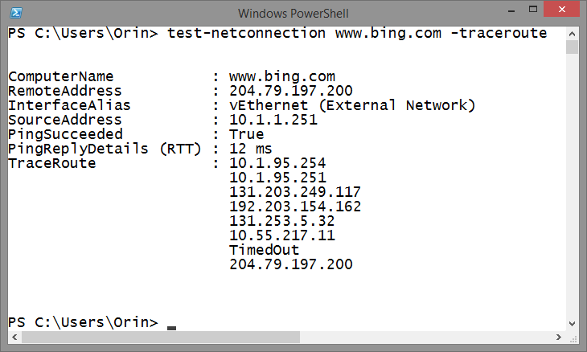
Verify Network Adapter Connectivity
Test-NetConnection bing.com -traceroute

Slide 22
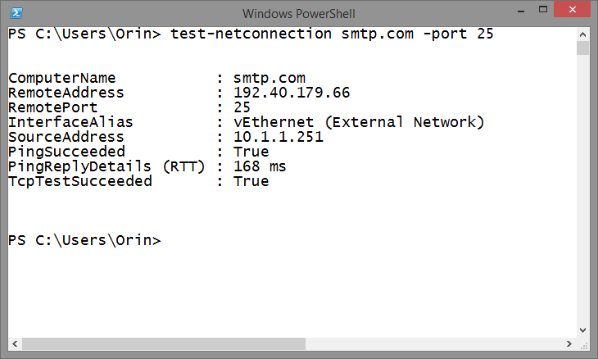
Verify Network Adapter Connectivity
Test-NetConnection smtp.com –Port 25

Slide 23
Repair Trust Relationship
Test-ComputerSecurechannel -credential domain\admin -Repair

Slide 24
Error Event Logs
Get-Eventlog -logname System -EntryType Error

Slide 25
Manage Services
Stop-Service
Start-Service
Restart-Service
Set-Service
Get-Service

Slide 26
View Stopped Services
Get-Service | Where-Object {$_.Status –eq “Stopped”}

Slide 27
Add Roles and Features
Install-WindowsFeature
-IncludeAllSubfeature
-IncludeManagementTools File-Services

Slide 28
Add Roles .NET Framework
Install-WindowsFeature Net-Framework-Core -source d:\sources\sxs

Slide 29
View Installed Updates
Get-Hotfix

Slide 30
Firewall Basics

Slide 31
Add Firewall Rules Allow
New-NetFirewallRule -DisplayName “Allow Inbound Port 80" -Direction Inbound –LocalPort 80 -Protocol TCP -Action Allow

Slide 32
Add Firewall Rules Block
New-NetFirewallRule -DisplayName "Block Outbound Port 80" -Direction Outbound –LocalPort 80 -Protocol TCP -Action Block

Slide 33
Virtual Machine Basics

Slide 34
Create a new VM from a sysprepped VHD
New-VM -MemoryStartupBytes 2048MB -Name NZ-VM -Path "d:\NZ-VM" -VHDPath "d:\NZ-VM\disk.vhdx"

Slide 35
Assign VM Network Adapter to Virtual Switch
GET-VM –name NZ* | GET-VMNetworkAdapter | Connect-VMNetworkAdapter –Switchname ‘Private Network’

Slide 36
PowerShell Direct

Slide 37
Allows you to run PowerShell commands from the Hyper-V Host inside a VM without remoting

Slide 38
Don’t have to sign in to VM or remote to VM to run commands or scripts on a local VM

Slide 39
Requires Windows 10 Windows Server 2016 Host & VM

Slide 40
Using PowerShell Direct
Enter-PSSession –VMName VMName
Invoke-Command –VMName VMName –ScriptBlock {Commands}

Slide 41
Active Directory Management

Slide 42
Ready a secure password
$newpwd = ConvertTo-SecureString -String "P@ssw0rd"
-AsPlainText –Force

Slide 43
New User
New-ADUser –Name Don.Funk –AccountPassword $newpwd

Slide 44
Enable New User
Enable-ADAccount –Identity Don.Funk

Slide 45
Reset Password & Force Change
Set-ADAccountPassword Don.Funk -NewPassword $newpwd -Reset -PassThru | Set-ADuser -ChangePasswordAtLogon $True

Slide 46
New Group
New-ADGroup -Name “Aucklanders" -SamAccountName Aucklanders -GroupCategory Security -GroupScope Global -Path "CN=Users,DC=IgniteNZ,DC=Internal"

Slide 47
Search for accounts with non-expiring passwords
Search-ADAccount –PasswordNeverExpires

Slide 48
Search for accounts that haven’t signed-on for 90 days
Search-AdAccount –accountinactive
–timespan 90.00:00:00

Slide 49
Search for locked out accounts
Search-AdAccount –Lockedout

Slide 50
Search for disabled accounts
Search-AdAccount –AccountDisabled

Slide 51
DEMO: BASIC AD ADMINISTRATION

Slide 52
ISE Snippets

Slide 53
Allow you to add frequently used PowerShell code to a special menu in PowerShell ISE

Slide 54
Requires execution policy be set to unrestricted

Slide 55
Secure Password Snippet
New-IseSnippet -Force -Title "Password_String" -Description "Secure Password String" -Text "`$newpwd = ConvertTo-SecureString -String P@ssw0rd -AsPlainText –Force"

Slide 56
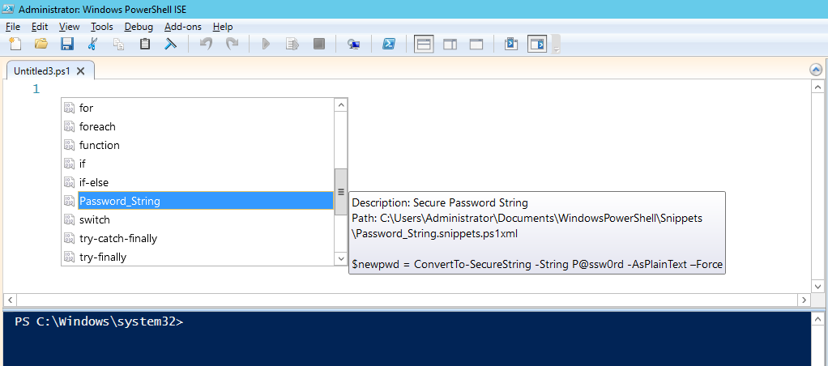

Slide 57
DEMO: SNIPPETS

Slide 58
DNS Management

Slide 59
New DNS Primary Zone
Add-DnsServerPrimaryZone -Name "westisland.ignitenz.internal" -ReplicationScope "Forest" -PassThru

Slide 60
New Record
Add-DnsServerResourceRecordA -Name “wellington" -ZoneName "igniteNZ.internal" -AllowUpdateAny -IPv4Address "172.18.99.23" -TimeToLive 01:00:00

Slide 61
DEMO: BASIC DNS

Slide 62
DHCP Management

Slide 63
New Scope
Add-DhcpServerv4Scope -Name "Alpha-Scope" -StartRange 172.16.0.0 -EndRange 172.16.0.254 -SubnetMask 255.255.255.0

Slide 64
New Reservation
Add-DhcpServerv4Reservation -ComputerName domaincontrol.igniteNZ.internal -ScopeId 172.16.0.0 -IPAddress 172.16.0.200 -ClientId F0-DE-F1-7A-00-5E -Description "Reservation for Printer"

Slide 65
New Scope Setting - DNS
Set-DhcpServerv4OptionValue -ComputerName domaincontrol.igniteNZ.internal -ScopeId 172.16.0.0 -OptionId 006 -Value "172.16.0.10"

Slide 66
New Scope Setting - Gateway
Set-DhcpServerv4OptionValue -ComputerName domaincontrol.igniteNZ.internal -ScopeId 172.16.0.0 -OptionId 003 -Value "172.16.0.1"

Slide 67
DEMO: BASIC DHCP

Slide 68
File Server Management

Slide 69
New File Share
New-SmbShare –Name SharedFolder –Path C:\SharedFolder -FullAccess IgniteNZ\Administrator -ReadAccess IgniteNZ\Don.Funk

Slide 70
DEMO: BASIC FILE SHARES

Slide 71
Summary
-Basic configuration -Core role tools AD DS File Servers DHCP DNS -Snippits

Slide 72
Q&A

Slide 73

Related Ignite NZ Sessions
Required Slide
*delete this box once you have listed content that is related to your session.
Speakers, please list the other Breakout Sessions that relate to your session.
Also indicate where and when they can find you, to continue the discussion.
If you’re going to be at Hub Happy Hour (5.30-6.30pm Wed and Thu, let them know)
1
What’s new in Windows Server Hyper-V
2
Virtualization Vision & Strategy
3
Microsoft’s New Windows Server Containers

Slide 74





Resources
Microsoft Virtual Academy
TechNet & MSDN Flash
Free Online Learning
http://aka.ms/mva
Subscribe to our fortnightly newsletter
http://aka.ms/technetnz http://aka.ms/msdnnz
Sessions on Demand
http://aka.ms/ch9nz

Slide 75


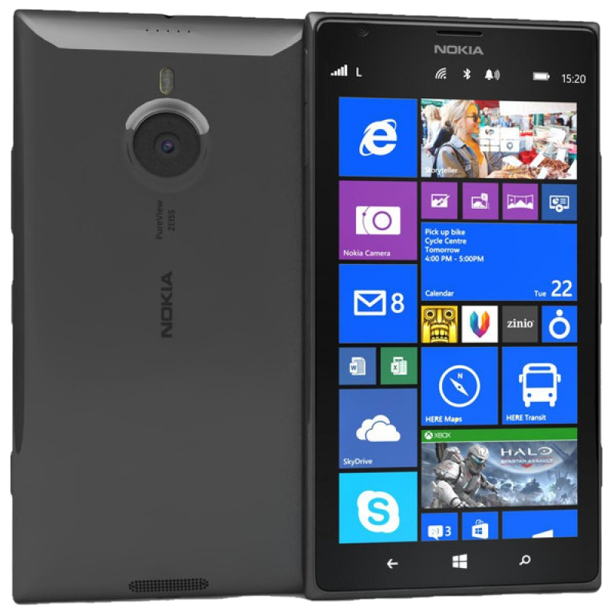


Complete your session evaluation now and be in to win!

